Slide 1
Container Orchestration

Slide 2
What is a Container?
Lightweight, stand-alone, executable package of a piece of software
Includes all of the dependencies
Runs the same regardless of environment
Isolated from other applications
Notes:
Talk about c-groups
Uses the linux kernel
Technically has existed for a long time

Slide 3
Linux and CGroups
Control groups
Limits, accounts and isolates resource usages
Started at Google (Paul Menage and Rohit Seth) in 2007
Originally called Containers, but changed to avoid confusion
Merged into mainline kernal at version 2.6.24 in 2008

Slide 4
What uses CGroups?
Notes:
Core OS
Docker
Hadoop
Jelastic
Lmctfy
Lxc
Mesos

Slide 5
How does a Container Differ from a VM?

Slide 6
Containers and VMs

Slide 7
Docker
Has multiple versions (CE, EE, Moby)
Most likely the tool you will encounter when looking for containers
Supports multiple platforms (Mac, Windows, Linux)
Has a Public Repository for Images

Slide 8
Docker Image vs Container
Image is a recipe or blue print describing a desired initial state for a container
Read Only
Transportable
Container is the isolated process actually executing
State can change as the container runs
Ephemeral by default

Slide 9
Make a Simple Container
Create a Dockerfile
Create a simple NodeJS App
Build the Image
Run the Container
Notes:
Talk about Docker Configuration
Volumes
Ports
Environment variables

Slide 10
What is Orchestration?
Provisioning Hosts
Managing Containers
What to do with failed containers?
Linking containers
Exposing services
Scaling the cluster
Notes:
Upgrading Clusters
Node failures
Container Migration
Balancing Nodes

Slide 11
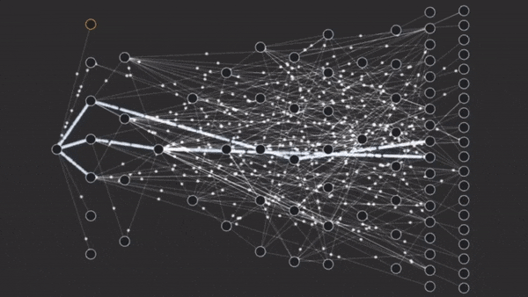
What is a Microservice?
Notes:
Break up traditionally huge services into smaller (micro) services
Allows for service to be highly specialised
Allows for easy scaling of services (Limits impact and only scales services that need to be scaled)

Slide 12
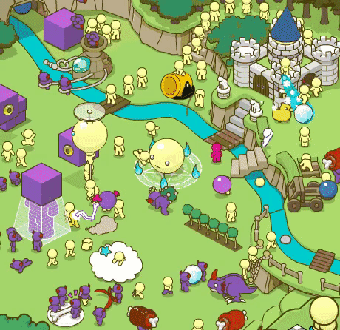
Microservices in Reality

Slide 13
Lets use Docker-Compose
Simple method to define multiple docker containers
Allows for managing everything via YAML files
Create a docker-compose.yml file
Create a set of new services with node

Slide 14
Docker Swarm
Improve Orchestration by allowing for redundancy
Network all of the nodes
Natural Extension of Docker Compose

Slide 15
Lets use Docker Swarm
Perform the same example as the Docker Compose, but using Swarm instead

Slide 16
Kubernetes
Orchestration tool developed by Google for container orchestration
Provides more features than Swarm
But Swarm is catching up
Considered a Market Leader in Orchestration
Is not tied to Docker

Slide 17
Lets use Kubernetes
Build a Kubernetes cluster using minikube
Same example as for Swarm and Docker Compose

Slide 18
References
https://en.wikipedia.org/wiki/Cgroups

